Slide 1
Welcome
to
glow maker
A Way to Beauty..
Notes:
Respected judges/faculty and my fellow classmates, good morning/afternoon. Today, I am excited to present Glow Maker, a D2C skincare brand designed to make effective skincare simple, affordable, and accessible.
Operating in the rapidly growing Indian D2C beauty market, Glow Maker solves the everyday skincare confusion for Gen Z and young millennials through our signature 3-step daily routine.

Slide 2
glow makerz
C.E.O | C.F.O | C.M.O | C.O.O | P.D.M
Rijia Sultana | Aryan Paul | Souradeep Maji | Joyanto Sinha | Vishal Chauhan
Notes:
Next, I would like to introduce our founding team behind Glow Maker and our leadership structure:
Rijia Sultana (CEO): Leads our overarching business vision, strategic direction, and external partnerships.
Samarto Dey (CFO): Manages our unit economics, pricing strategy, product margins, and cash flow planning.
Souradeep Maji (CMO): Heads brand marketing, customer acquisition, and influencer marketing campaigns.
Joyanto Sinha (COO): Handles supply chain operations, inventory tracking, packaging, and fulfillment logistics.
Anirjit Banerjee (PDM): Directs product research, formulation safety testing, and manufacturing coordination.

Slide 3
A short intro of their tasks
C.E.O
Chief Executive Officer
Leads the company and the team.
Maker major business decisions.
Sets the company’s goal and vision.
Represents GlowMakers during presentations.
C.F.O
Chief Financial Officer
Manages the company's budget.
Calculates product costs, prices and profit.
Tracks income and expenses.
Plans how to use the company's money.
C.M.O
Chief Marketing Officer
Promotes GlowMakers products.
Plans social media advertisements and campaigns.
Understands customer needs.
Builds brands awareness to attract customers.
C.O.O
Chief Operating Officer
Manages daily business operations.
Coordinates manufacturing, packaging and delivery.
Checks stock and order management.
Helps ensure the business runs smoothly.
P.D.M
Product Development Manager
Develops new product ideas.
Plans product features, packaging and design.
Researches customer preferences and product requirements.
Works with qualified manufacturers to develop and test safe formulations.

Slide 4
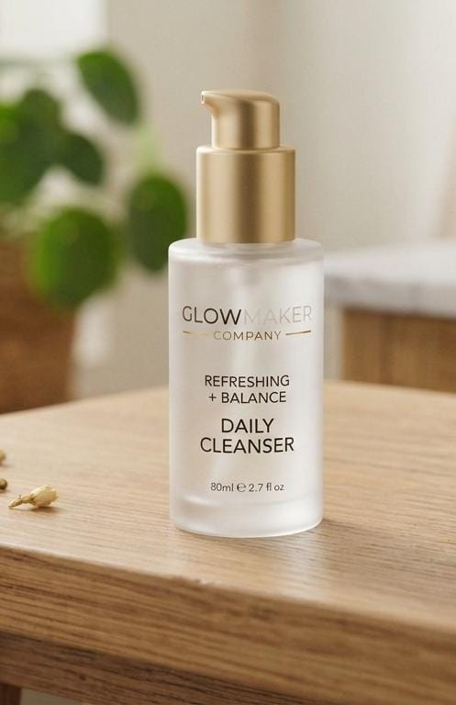
What we offer
We offer three types of products:
Daily use cleanser :
Meet your daily reset in a bottle.
Say goodbye to dull, tired skin and hello to an effortless glow!
Glow Maker Daily Cleanser gently washes away impurities, excess oil, and makeup without stripping your skin’s natural moisture barrier. Formulated for everyday use, it clears away the day to reveal a soft, fresh, and hydrated complexion every morning and night.
Cleanse. Refresh. Glow.
only in ₹349

Slide 5
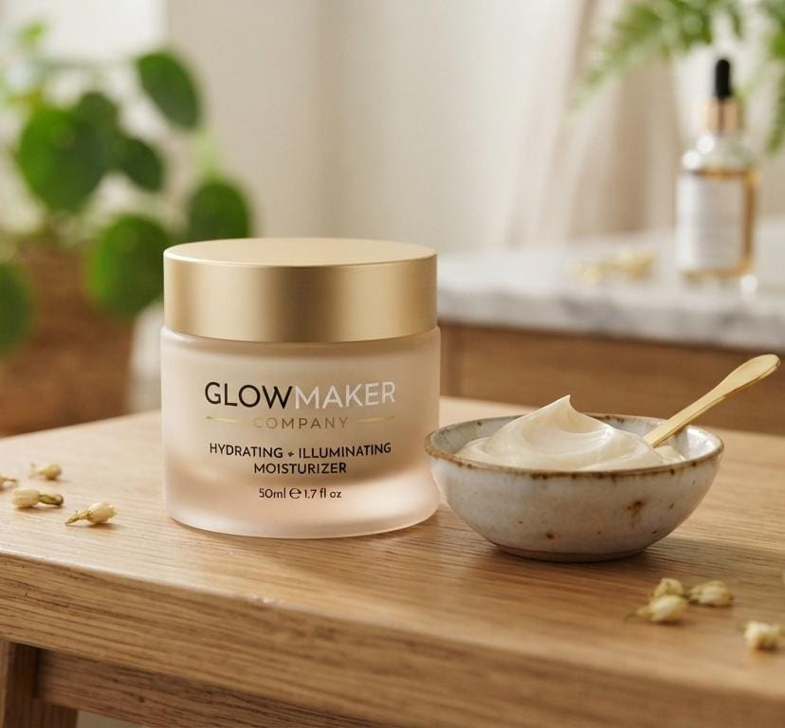
And ALSO
For dry skin we offer:
Glow maker Moisturizer
Your daily dose of dewy, effortless glow.
Say goodbye to dry, dull skin and hello to weightless hydration!
Glow Maker Daily Moisturizer melts effortlessly into your skin, locking in moisture without any greasy feel. Formulated for everyday wear, it instantly plumps, smooths, and restores your natural radiance so you can glow with confidence all day long.
Hydrate. Plump. Glow.
only in ₹499

Slide 6

in sunblock segment
We are proudly offering:
Glow Maker Sun Shield SPF 50
Sun protection that glowing skin actually loves.
Protect your radiant look while shielding your skin from harmful rays! Glow Maker Sun Shield SPF 50 offers high-performance Broad Spectrum protection without the heavy white cast or sticky feel. Formulated for everyday wear, it glides on smoothly, melts in seamlessly, and leaves behind a lightweight, dewy finish that lasts all day.
Shield. Hydrate. Glow.
now in ₹449

Slide 7
MARKET ANALYSIS
Target Customer Profile
Gen Z & Millennials
Urban consumers aged 18-32 seeking minimal, glass-skin aesthetic routines.
Core Pain Points
Overwhelmed by complex 10-step routines, heavy white casts, and high K- beauty prices.
The Glow Maker Pitch
A clean, affordable 3-step daily ritual engineered for real Indian skin tones.

Slide 8
Thanks!
Do you have any questions?
srijia441l@gmail.com
+91 97331 22140
Presented by : Rijia Sultana
Please keep this slide for attribution

